Slide 1
SME Bootcamp: How to get started

Slide 2
Where do companies learn about you?

Slide 3
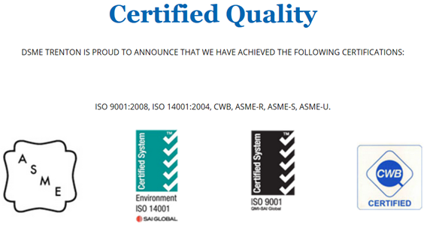
Websites
A website is usually the first introduction for a Prime Contractor to your company.
The following is a list of what a strong website traditionally showcases:
Certifications and contact information visible on homepage.
Aesthetically pleasing (high resolution photos, simple layout, professional formatting).
Limited number of tabs.
Drop down features allow more explicit options while avoiding the potential of crowding the homepage with tabs.

Slide 4
Website Support
ACOA’s Business Development Program can help.
Provides up to $500,000 in assistance to your project

Slide 5
Where can I learn about opportunities?

Slide 6
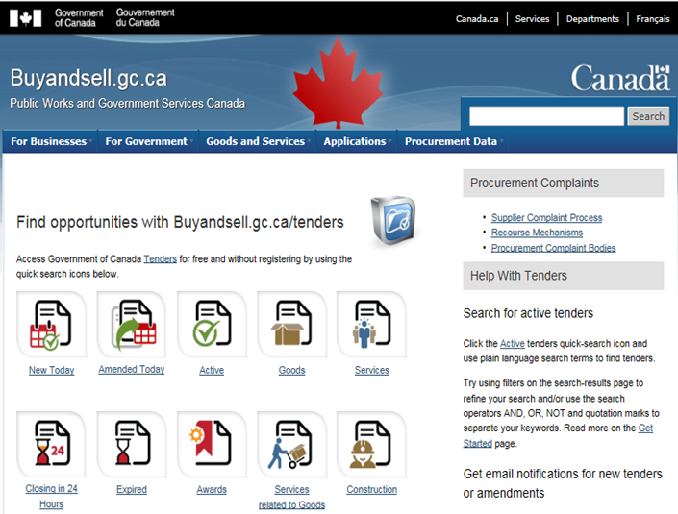
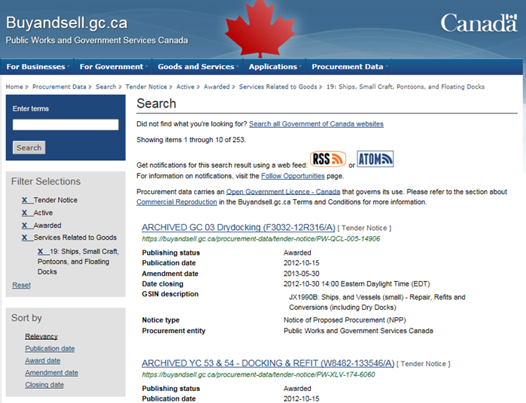
Buy and Sell
The Government of Canada will post all procurement opportunities on buyandsell.gc.ca
From here you can filter your selection to find a project suitable for you and follow that project or project area by clicking the RSS or ATOM button.
Notes:
*Chance to minimize presentation and show live what each step looks like*

Slide 7
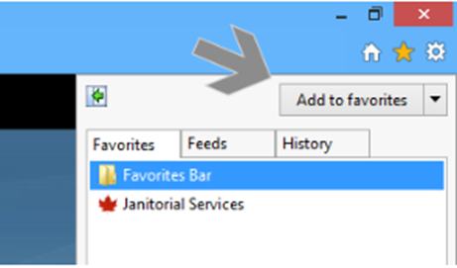
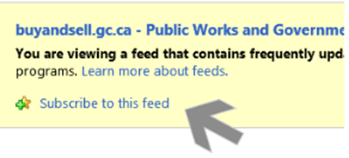
Buy and Sell
Additional methods to track updates on a project are listed below:
Favourite the ULR of your intended project.
Subscribe to search feed using your browser’s feed reader.
Notes:
*Chance to minimize presentation and show live what each step looks like*

Slide 8
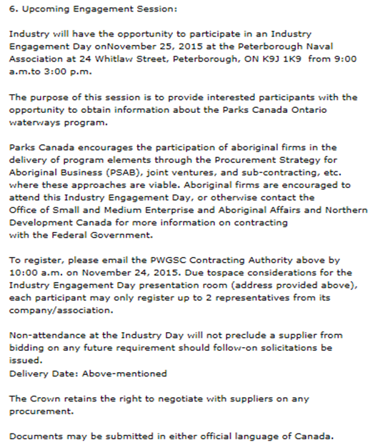
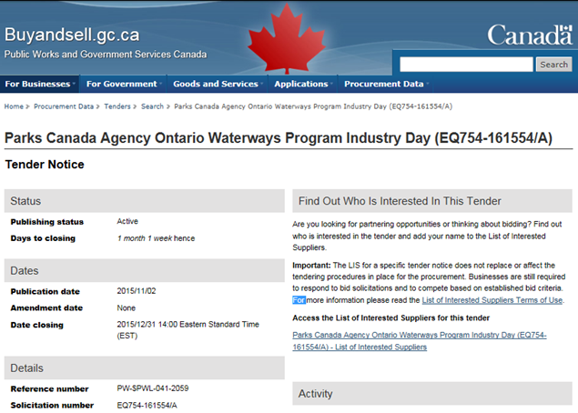
Industry Days
Organized by the Government of Canada, an Industry Day provides an opportunity for the federal government to present information on an upcoming procurement to industry.
All Industry Days will be posted on buyandsell.gc.ca
It is mandatory to sign up prior to the scheduled date to secure a spot.
Industry Days will often include an option
to participate via teleconference or video
conference for those unable to attend in
person.
Use the search bar and filter options to
locate a desired Industry Day.

Slide 9
Getting Involved
Following an Industry Day, companies are encouraged to offer input on the project details, including the makeup of the Value Proposition framework.
Recommendations can be made in writing or through one-on-one meetings with the project team.
Recommendations can be made by potential bidders or suppliers.
For example: An SME recommends that the Government of Canada weight the Value Proposition highly on an Ocean based project because significant capability exists in Canada in this sector.

Slide 10
Regional Development Agencies (RDAs)
ACOA plays a critical matchmaking role.
Often the first point of contact for Prime Contractors looking to grow their supply chain(s).
ACOA participates in the development of Value Proposition Frameworks.
Sits on ITB evaluations.

Slide 11
Industry Associations
Support to SMEs:
Promotion of member companies.
Advocacy and facilitating engagement with appropriate provincial and federal partners.
Representation at International and National events.
Portal to appropriate events and supply chain.
Facilitate relevant B2B introductions.
Listing in Capabilities Guide and web site promotion.
Marketing and promoting members capabilities and solution offerings.
Assist in delivering events and workshops etc. with appropriate partners.
Facilitating supply chain development and partnership support.
Engagement with educational institution and R&D collaborations.
Trade Show and Trade Mission support and facilitation.

Slide 12
Trade Shows
Trade shows are an important way to increase visibility, discover new opportunities, and meet key contacts.
A list of valuable trade shows are as follows:
DEFSEC – September 2016
CANSEC – May 25-26, 2016

Slide 13
Trade Show Support
ACOA’s Business Development Program supports Participation at trade shows.
ACOA Nova Scotia – Regional Trade Missions
Caribbean twice per year, Latin and South America, Europe and Asia Missions are usually planned 6-12 months in advance.
Registration fee of $500 pays for all business support activities;
Matchmaking
Customized meeting program
Ground transportation
Translation services (if needed)
All other travel expenses are the company’s expense.

Slide 14
Trade Show Support
If you want to go to a particular market or trade show, ACOA can help.
EMBA Program Poland March 2016, Vietnam March 2017
Columbia and Ecuador February 2016 – 1 space available
Caribbean Renewal Energy Forum October 2016
Inbound missions also possible – need to have multiple company reach
Contact your nearest ACOA office to discuss your project.

Slide 15
How do I connect with a Prime Contractor?

Slide 16
Business Pitch
Simply contacting a Prime to work with you will generally not be enough.
Have a strong understanding of the ITB Policy before contacting a prime.
IE: Are you an SME?
What is your estimated Canadian Content Value (CCV)?
To help secure a contract utilize the following tips to create an effective business proposal:
Begin by making sure you completely understand both your and your competitors’ brands.
What are your competitive advantages?
Why are you unique?
What can you bring that others can not?
Choose your target Prime(s) but talk to many Primes, not just one or two.
Avoid wasting your time and resources on Primes that do not fit with your product list.

Slide 17
Business Pitch
Why would your partnership benefit them?
Focus on the benefits your company will produce for the Prime rather than how the partnership will help you.
Cost savings, better products, multiplies….etc.
Assign someone to be responsible for dealing with the on-going contact with the Prime.
It is important to be available to communicate correct information with Primes and in a prompt time frame.

Slide 18
Business Pitch
Contact with a Prime will often begin with an email or phone call, it is important to utilize the points suggested in the slides prior to develop the most attractive proposal.
A future meeting may be conducted if interest is sparked.
Prime Contractors may be interested in conducting a site visit.

Slide 19
Marketing Support
ACOA’s Business Development Program.
ACOA can finance up to 75% of the costs of developing a marketing plan and of hiring a marketing manager to implement the plan. Other eligible activities include designing new labels and packaging, promotional materials, advertising, product demonstrations, participation at trade shows and export-related activities.

Slide 20
Preparing to work with a Prime Contractor

Slide 21
Certifications
ISO 9001:2008
An internationally recognized certification stating that an organization has a Quality Management System.
AS9100(c)
Revised as of January 2009.
Fully incorporates the entirety of the current version of ISO 9001, while adding requirements relating to quality and safety.
Created as a means to satisfy internal, government, and regulatory requirements applicable to the aerospace industry-requirements that ISO, as a generic standard, was never designed to satisfy.
Canada’s Controlled Goods Program Registration
Canada’s Controlled Goods Program (CGP) was formed in 2001 by the Department of Public Works and Government Services Canada (PWGSC).
Its purpose is to strengthen Canada’s defence trade controls of controlled goods and services through processes of: registration, prevention, deterrence, and detention.

Slide 22
Controlled Goods Program (CGP)
Established in 2001 to support Canada's International Traffic in Arms Regulations (ITAR) exemption.
Enhanced in 2011 to meet the requirements of the new ITAR dual national rule and Canada's own threat assessments.
Regulates the access of controlled goods in Canada. Includes examination, possession, or transfer of controlled goods.
Designed to prevent risk of diversion and proliferation of articles and technologies including those which could assist in the creation of weapons of mass destruction.

Slide 23
Registration is mandatory
Anyone who possesses, examines or transfers controlled goods in Canada, must be registered with the Controlled Goods Program.
Registrants must be security assessed.
The security of controlled goods is a shared responsibility between government and industry.
The organization is responsible for maintaining compliance with Controlled Goods Regulations and Defence Production Act provisions.

Slide 24
Who Can Register?
Registered Persons
Corporations and unincorporated businesses.
Excluded Persons
Employees of federal, provincial and territorial Governments, and Federal Crown Corporations, Peace Officers and members of a visiting force.
Exempted Persons
Temporary workers, visitors, business registered under the International Traffic in Arms Regulations (ITAR), and US government officials.

Slide 25
What are Controlled Goods?
Export Control List
Group 2 – Munitions List: Automatic weapons, firearms, ammunition, components, projectors, bombs, fighter jets, tanks, missiles, chemicals, explosives, and related equipment and components, etc.
Group 5 – Strategic Goods: Global navigation satellite systems, ground control stations, and nuclear weapon design and testing equipment.
Group 6 – Missile Technology Control Regime: Missile technology – rocket systems, unmanned air vehicle systems, propulsion components and equipment.

Slide 26
What are Controlled Goods?
Controlled goods also encompass the development, production or use of a good.
For example:
Technical data (blueprints, formulae, engineering designs, models, etc.)
Technical assistance (instructions, training, working knowledge, etc.)

Slide 27
If you Examine, Possess or Transfer Controlled Goods
Register with the Controlled Goods Program.
Appoint a Designated Official (DO) who:
Conducts security assessments, for the risk of unauthorized transfer of controlled goods, on officers, directors and employees;
Develops and Implements security plans;
Maintains records (e.g. security assessments, Controlled Goods transfers);
Trains employees, visitors and temporary workers;
Reports security breaches and any changes to the organization and/or persons accessing Controlled Goods;
Transfers all high-score security assessments to the Controlled Goods Directorate for additional evaluation with security partners; and,
Provides updated lists of employees accessing Controlled Goods every 6 months.
All DOs must be trained and certified.

Slide 28
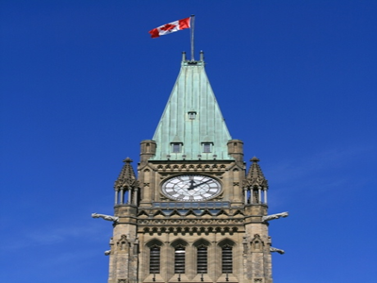
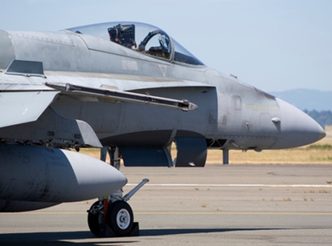
Strengthening Canada’s Security Together
+
Government and Industry
We both share a common interest: Security
http://ssi-iss.tpsgc-pwgsc.gc.ca/dmc-cgd/index-eng.html
(additional information including forms and contact information)

Slide 29
Support for Certification
ACOA can finance up to 75% of the cost of:
Training: Developing and implementing a human resources plan for your firm. Eligible costs include hiring human resource experts to deliver a training package based on the needs identified in the plan.
Productivity/Quality Improvement/Environmental Management Systems: Hiring consultants to develop and implement a productivity plan, a quality improvement plan or an environmental management system.
Consultant advice: Hiring a qualified consultant to prepare a business plan or feasibility study, investigate licensing opportunities, conduct a venture capital search, a technology transfer search, or provide mentoring services to improve your business skills.
Contact your nearest ACOA office to discuss your project.

Slide 30
Site Visits
Interested Primes will regularly request permission to perform a site visit of a company to verify the business relationship is suitable for them.
The following are important things to have done before a site visit:
Up-to-date financial records available upon request
Up-to-date safety precautions in place
Clean and professional looking work environment
Staff should be notified and prepared for the visit

Slide 31
Site Visits Support
ACOA and NSBI will often develop and participate in site visits with Prime Contractors looking to grow their supply chains.

